Slide 1
EPIDERMAL NEOPLASM DETECTION USING CONVOLUTIONAL NEURAL NETWORK
Under the guidance of: Team Members (Batch -02):
Dr. Ch. Venkata Narayana E. Stella (20761a05e9)
Professor Y. Harshitha Sampath (20761A05J2)
D. Dhanush Kumar (20761A05E8)

Slide 2
contents
Introduction
Related Work
Existing System
Proposed System
Dataset Description
Architecture Diagram
Methodology
Results
Future Scope
Conclusion
References

Slide 3
introduction
Skin cancer is a significant health concern worldwide, characterized by the abnormal growth of skin cells which is caused due to tanning beds and UV rays.
Early detection is crucial for successful treatment and improved outcomes in skin cancer.
In our project we have taken three models such as ResNet50,Inceptionv3 and VGG16. We trained these models on HAM10000 dataset which contains 10015 dermatoscopic images.
From the observations drawn we have concluded that Resnet50 gives the highest accuracy compared to other 2. We have given the results of each model with a confusion matrices and accuracy ,loss plots.
We have created a user interface which takes skin image as input and predicts the class.

Slide 4
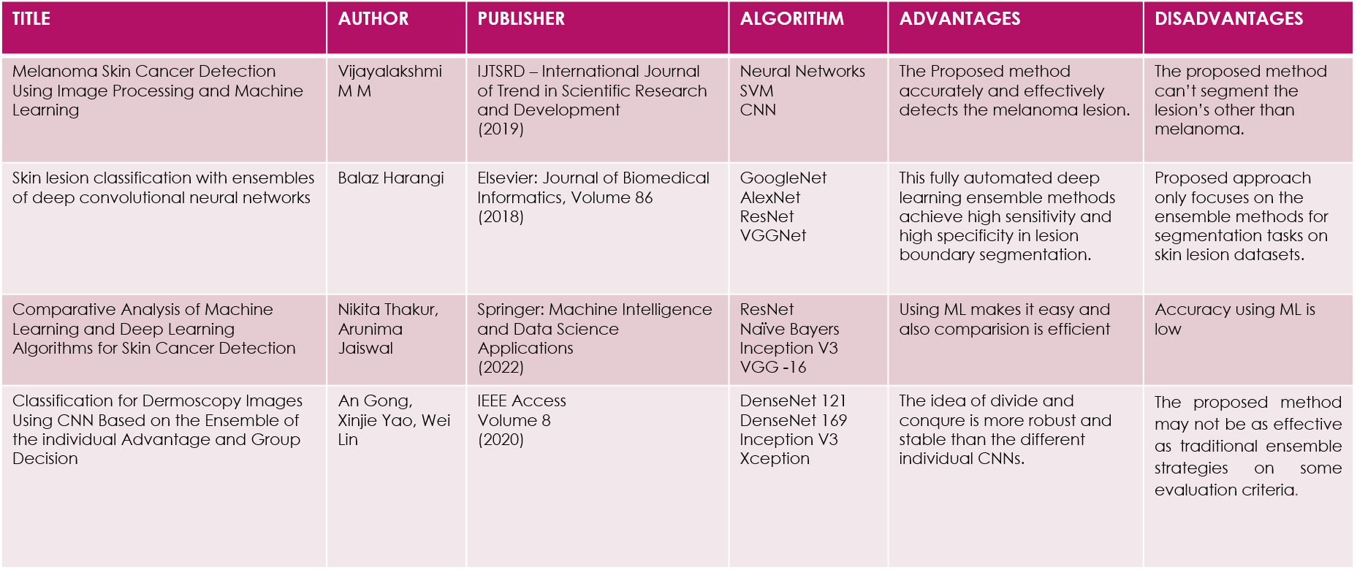
Related work

Slide 5
Existing system
The existing systems mainly classified melanoma, basal cell carcinoma, benign ,squamous cell carcinoma types of cancers. They have used different algorithms like basic CNN, Sequential models, EfficientNet, MobileNet, VGG16 Inceptionv3, ResNet etc .
Major Issues :
Accuracy
Lack of exploring different models
Permitted to only few classes

Slide 6
Proposed system:
In our project we have taken three models such as ResNet50, Inceptionv3 and VGG16.
7 classes of skin cancer are predicted.
From the observations drawn we have concluded that Resnet50 gives the highest accuracy compared to other 2.
Accuracy improved to 98 % for ResNet50 model.
We have given the results of each model with a confusion matrices and accuracy ,loss plots.
A user interface is created which takes skin image as input and predicts the class.

Slide 7
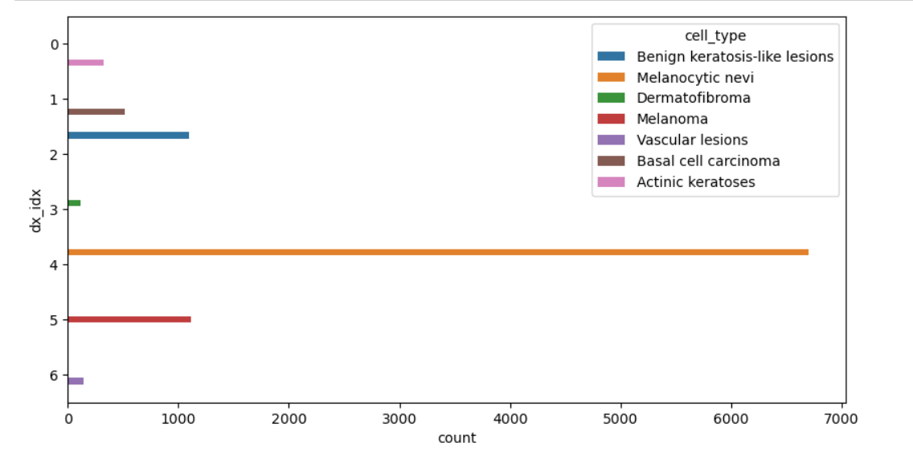
Dataset description
The dataset we have used is HAM10000 dataset which is a widely used collection of dermatoscopic images, specifically designed for research in the field of computer-aided diagnosis of skin lesions.
The dataset contains 10,015 dermatoscopic images of skin lesions, captured from a
diverse range of patients.
7 types of skin cancers are there namely Benign, Melanocytic nevi, Dermatofibroma,
Melanoma, Vascular lesions, Basal cell carcinoma, Actinic keratoses.
The size of the image is 450 x 600 pixels.

Slide 8
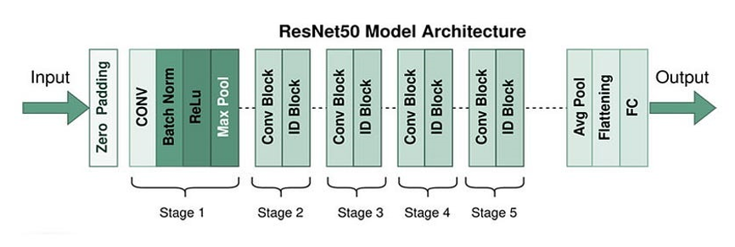
Architecture diagram
Zero padding layer: It is used to control the spatial dimensions of the feature maps that result from convolutional operations. Specifically, zero padding involves adding rows and columns of zeros around the input feature map before performing the convolution operation.

Slide 9
Convolutional 2D layer : Its purpose is to extract features from input images through the process of convolution.
Batch Normalization layer: It is applied after the convolutional or fully connected layers and before the activation function.
Activation Relu: It plays a crucial role in enabling neural networks to learn complex mappings between input features and target labels, leading to more effective and accurate models.
Max pooling layer : Its main purpose is to reduce the spatial dimensions of the feature maps while retaining the most important information.
Global average pooling layer: It is used for reducing spatial dimensions, simplifying network architecture, aggregating features, and improving computational efficiency.
Fully connected layer: It is responsible for learning non-linear mappings between input and output data. Performs classification and regression tasks and extract relevant features for decision making.

Slide 10
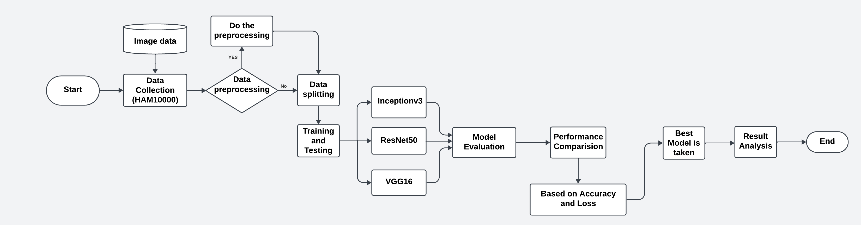
methodology

Slide 11
Data Collection: Data collection is a crucial step in various fields, including research, business, healthcare, and many others. The process involves gathering information.
Dataset Loading: Dataset loading is a crucial step ,we have to choose a dataset then download the dataset after we import required libraries then load the dataset.
Cleaning dataset: Cleaning a dataset is a crucial step in the data preprocessing pipeline. It involves identifying and handling missing data, dealing with outliers, addressing inconsistent or erroneous entries, and ensuring that the data is in a format suitable for analysis or model training.
Processing and Resizing Images: When working with image data, processing and resizing are common tasks, especially in the context of tasks like image classification or object detection.
Training and Test Split: This process helps you train your model on one subset, tune hyperparameters on another, and evaluate its performance on a third.
Feature Normalization: Normalization ensures that all features have similar scales, preventing some features from dominating others during the training process.

Slide 12
Data Augmentation: Data augmentation is a technique used to artificially increase the size of a dataset by applying various transformations to the existing data.
Model Selection (ResNet50, Inceptionv3, VGG16)
Build Model: Building a machine learning model involves defining its architecture, compiling it, and training it on a dataset.
Compile Model: Compiling a model involves specifying additional settings that are necessary for training. This includes the choice of an optimizer, a loss function, and metrics for evaluation.
Fit the model: Fitting the model involves training it on your dataset.
Evaluate model: Evaluating a trained model involves assessing its performance on a separate dataset that it hasn't seen during training, often referred to as the test set.
Considering the accuracies and loss of three models we have compared the performance of these models. And ResNet50 got the highest accuracy and lowest loss among three models.

Slide 13
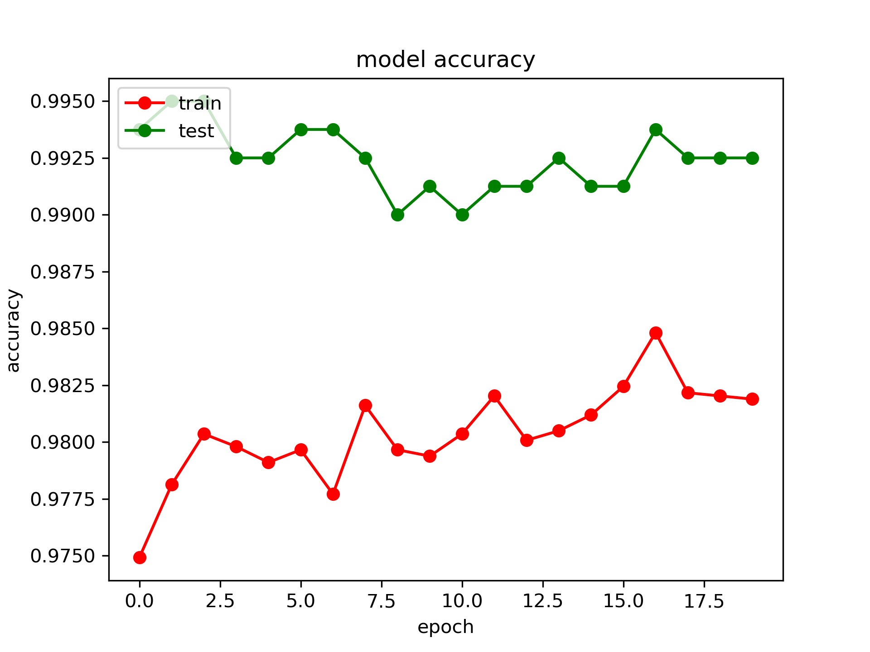
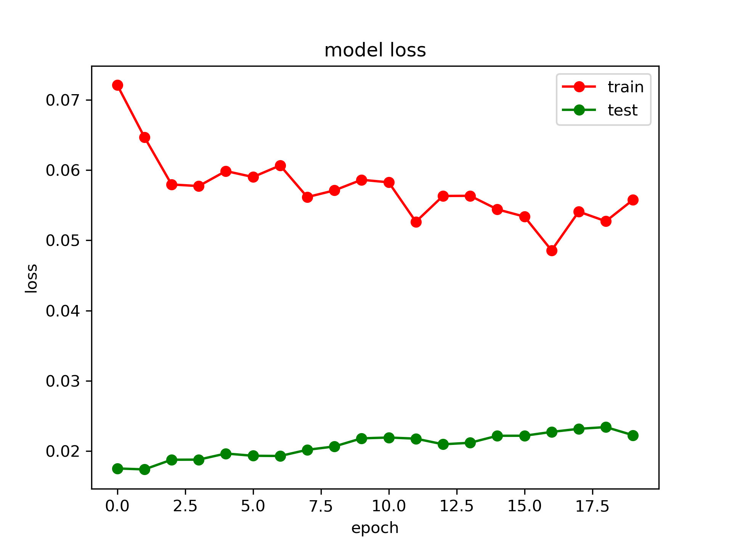
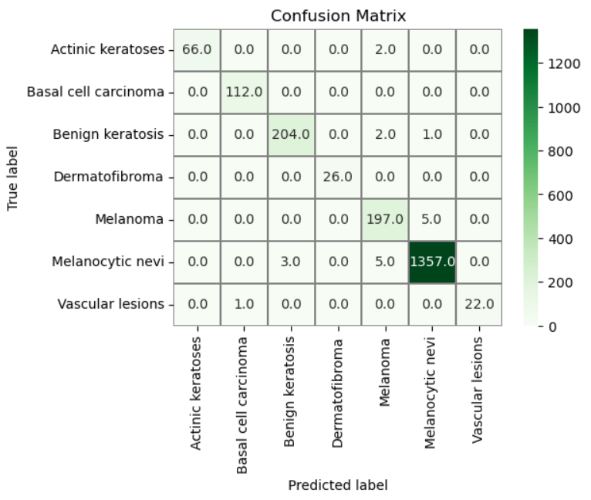
results
RESNET 50:
ResNet50 demonstrates exceptional predictive capabilities, achieving a test success percent of 98.9% and training success percent of 99.3%, with minimal losses.

Slide 14
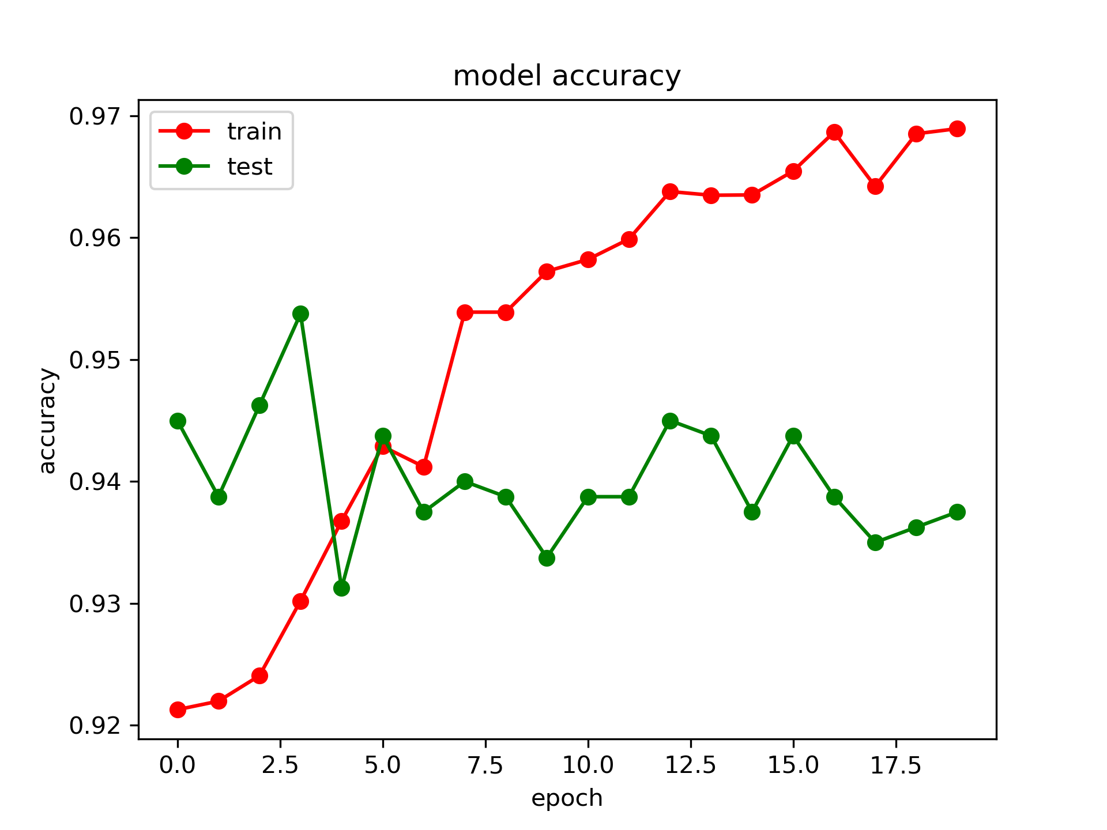
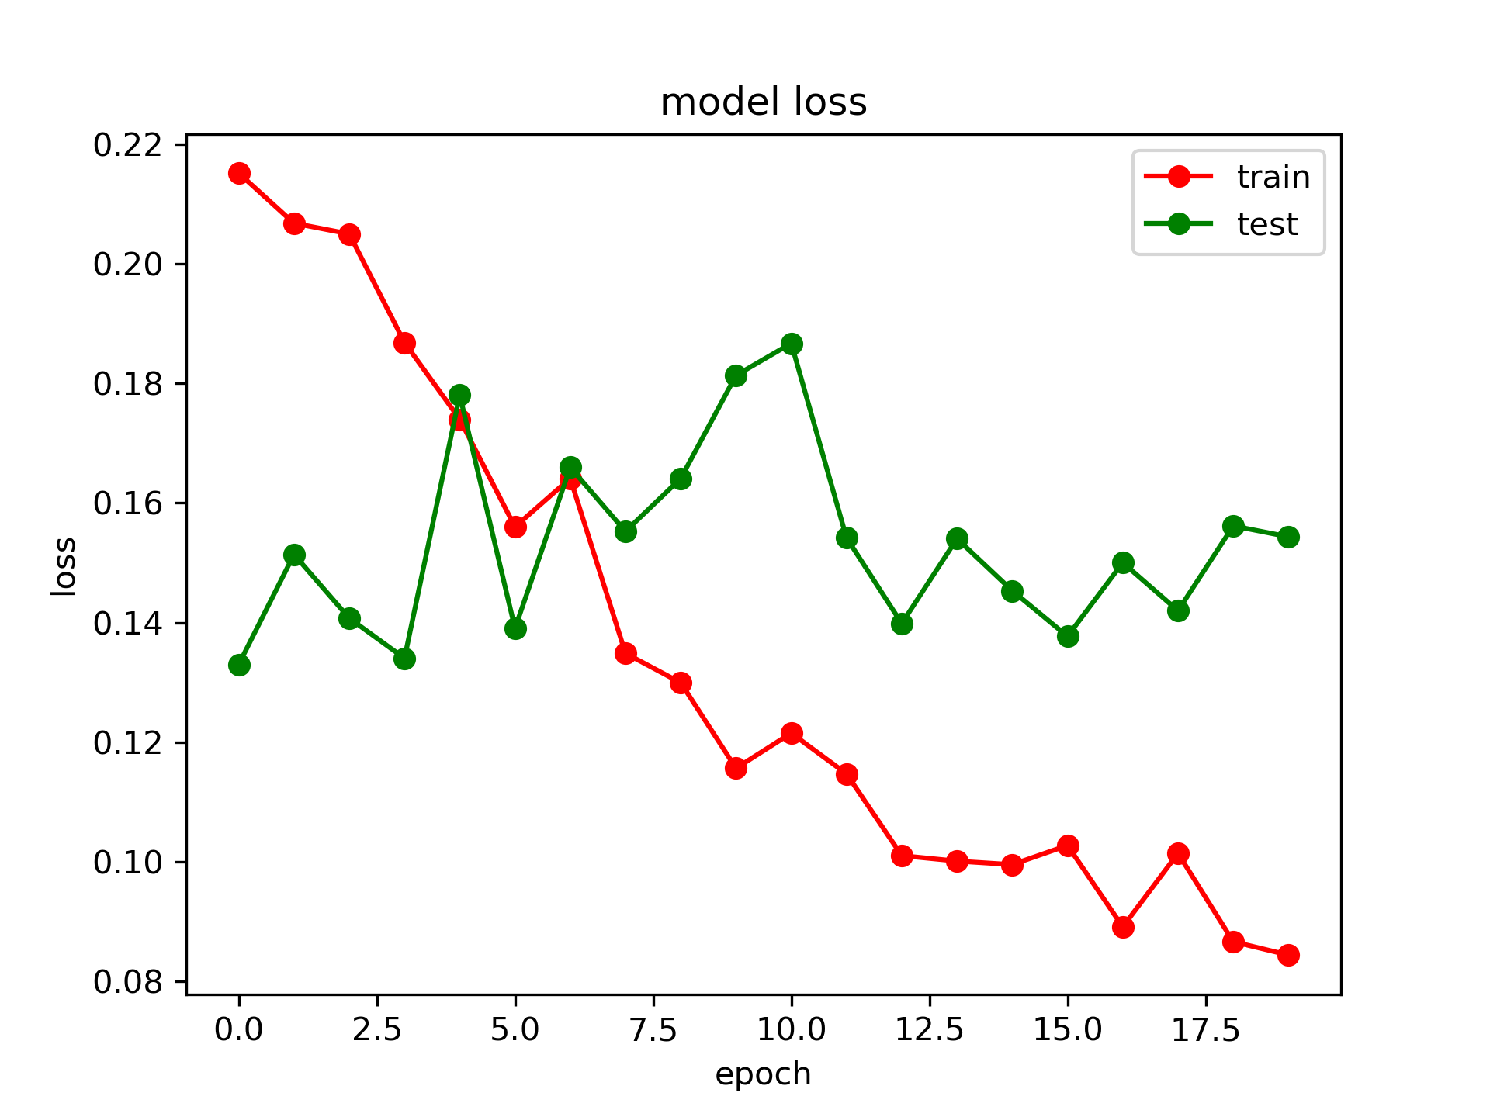
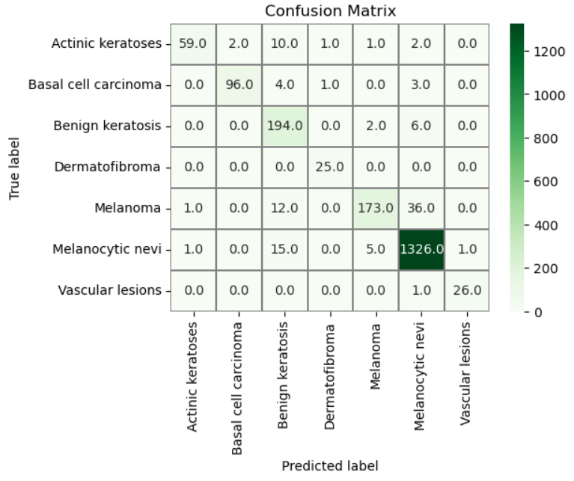
Cont…
InceptionV3:
Inceptionv3, while providing commendable results, exhibits a lower test and training success rate of 94.81% and 93.77%, respectively, with comparatively higher losses.

Slide 15
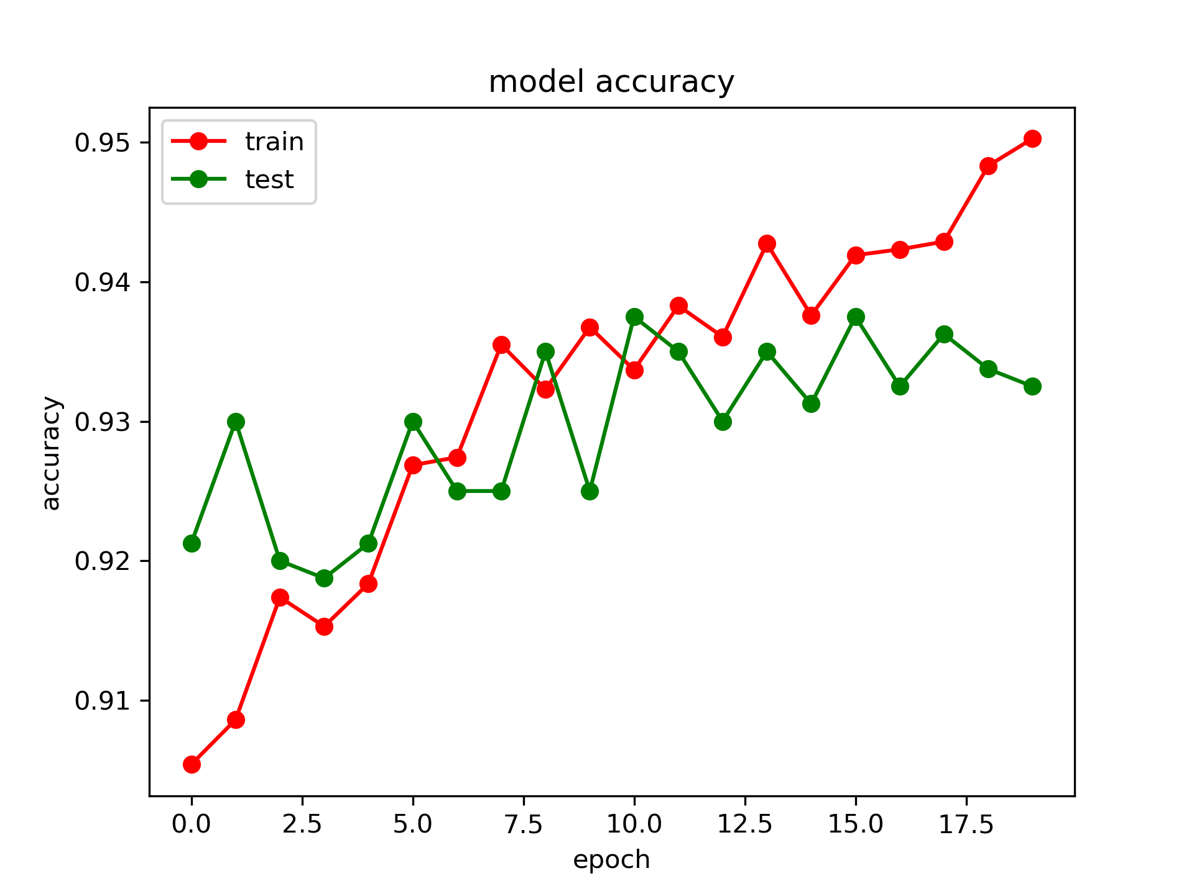
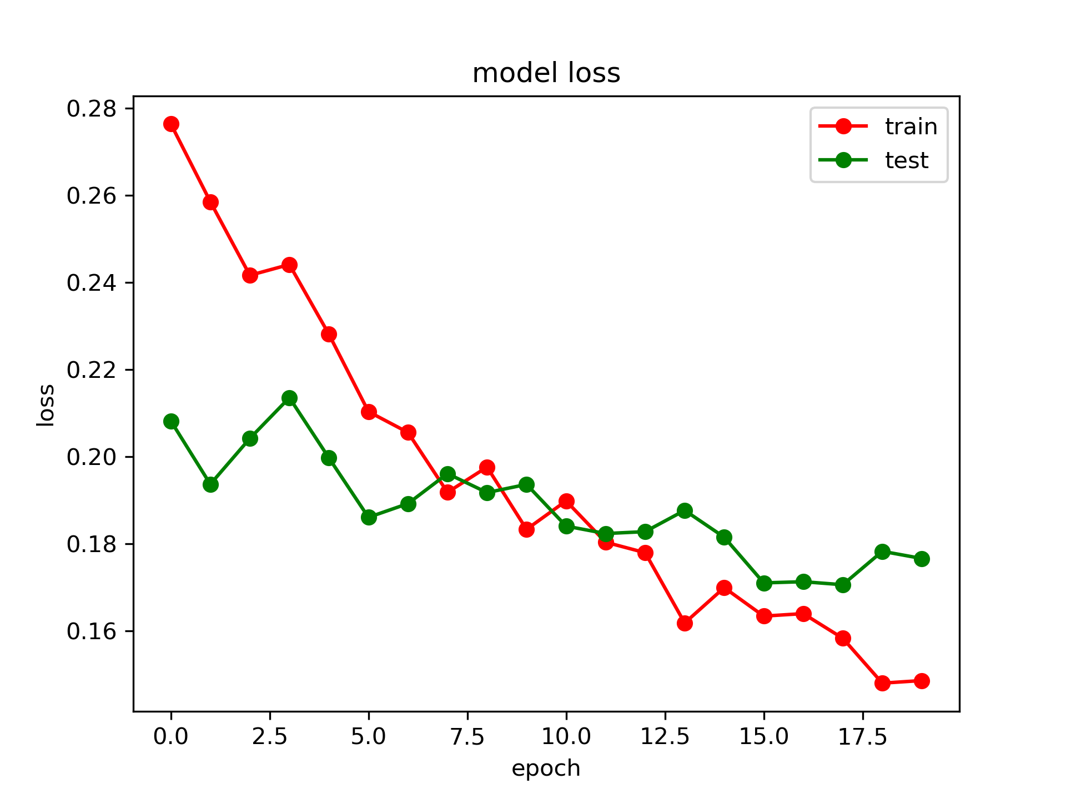

Cont…
VGG16:
VGG16, although delivering acceptable outcomes, falls behind ResNet50 and Inceptionv3, with a test success rate of 93.86% and a training success rate of 93.27%.

Slide 16
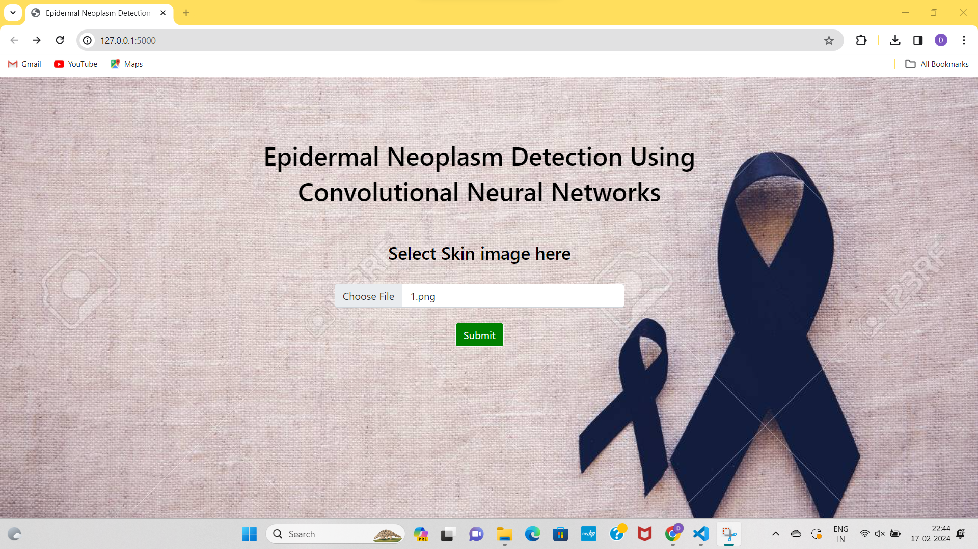
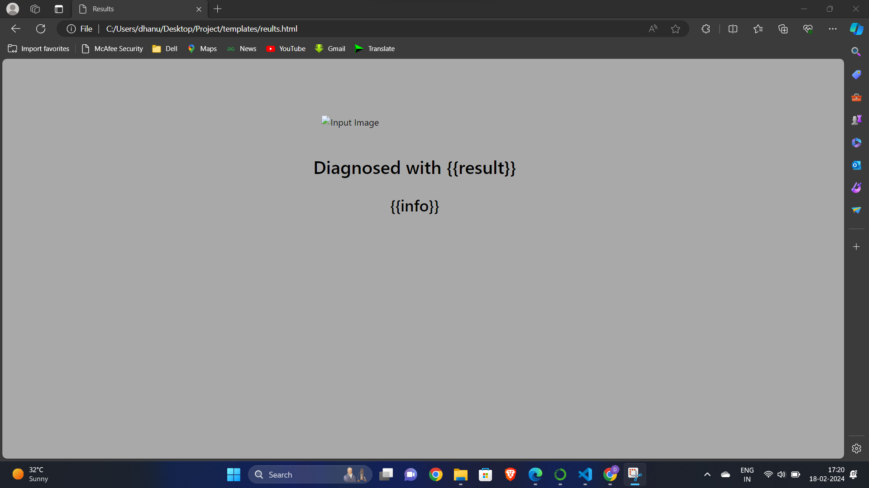
User interface
We have created an user interface to predict the type of the disease . It takes skin image as input and gives the type of the disease as output. It goes as follow:
Home Page: Output Page:

Slide 17
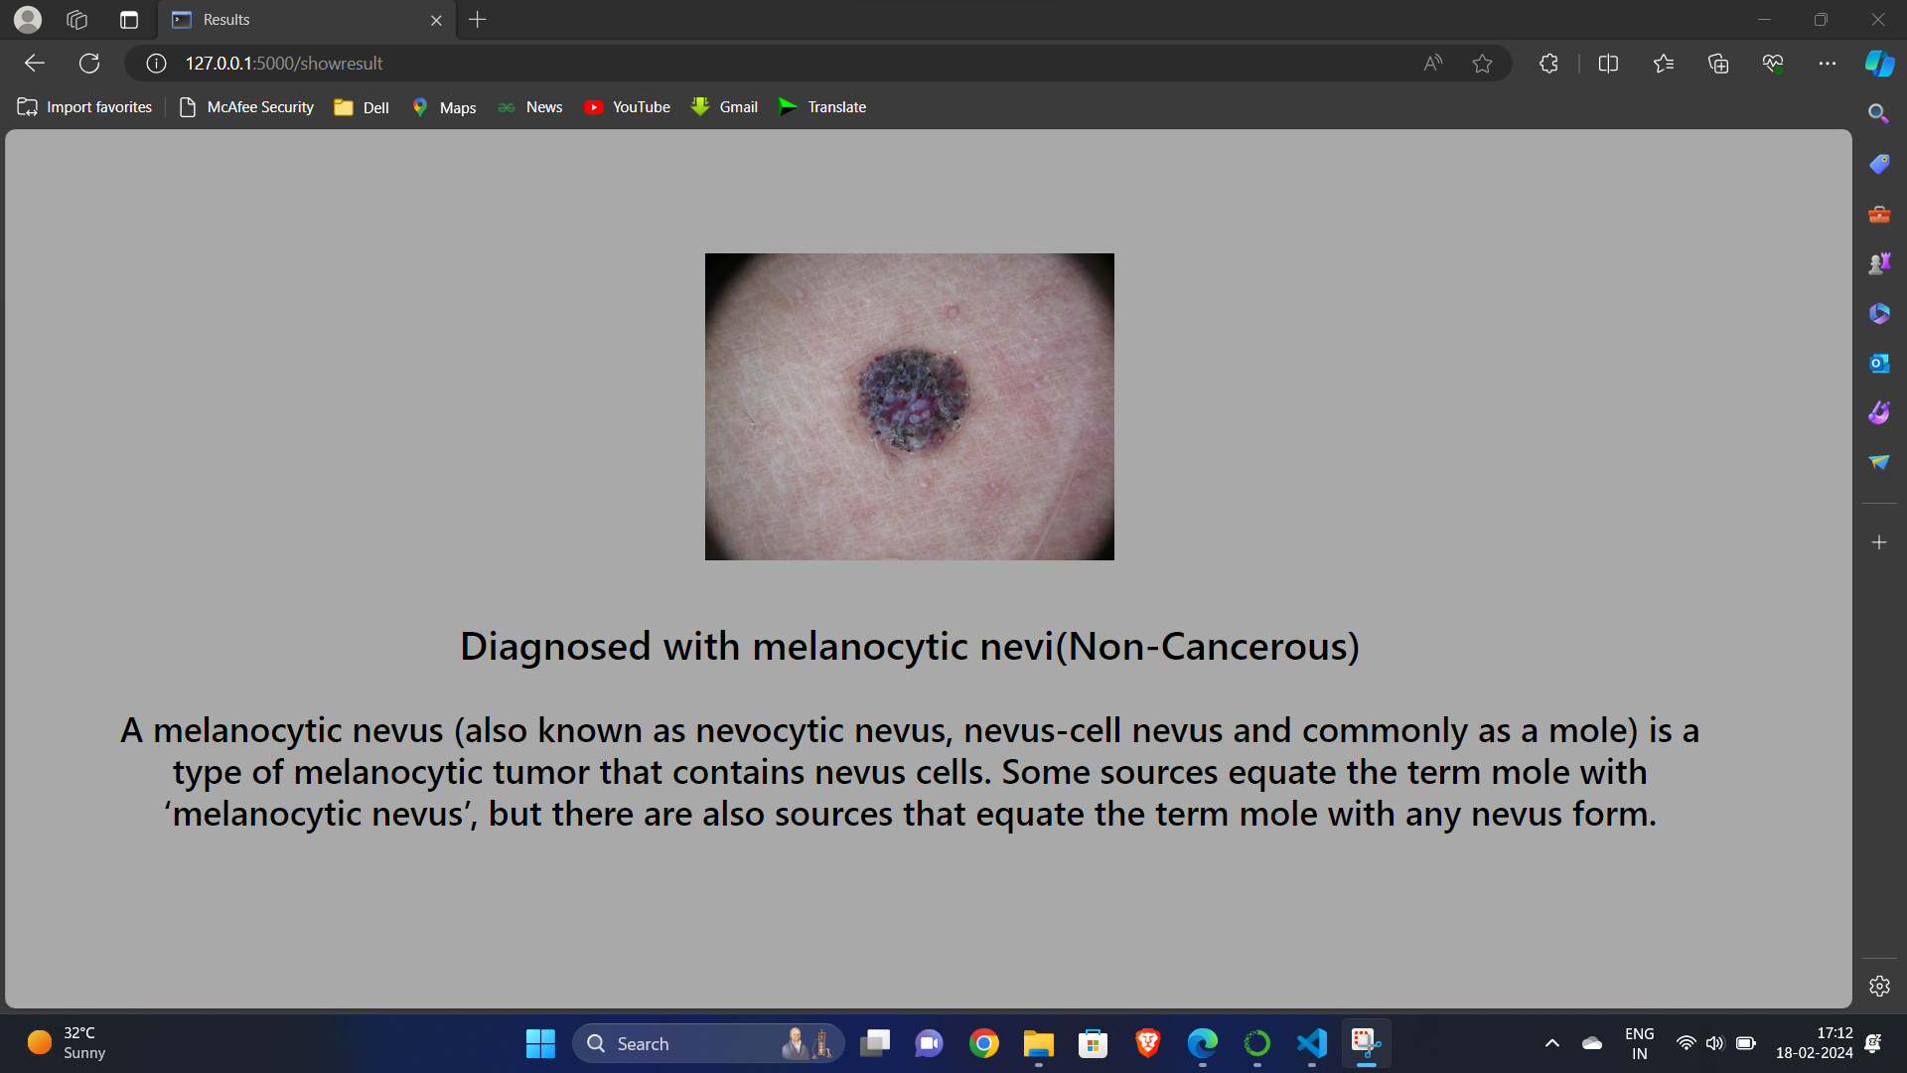
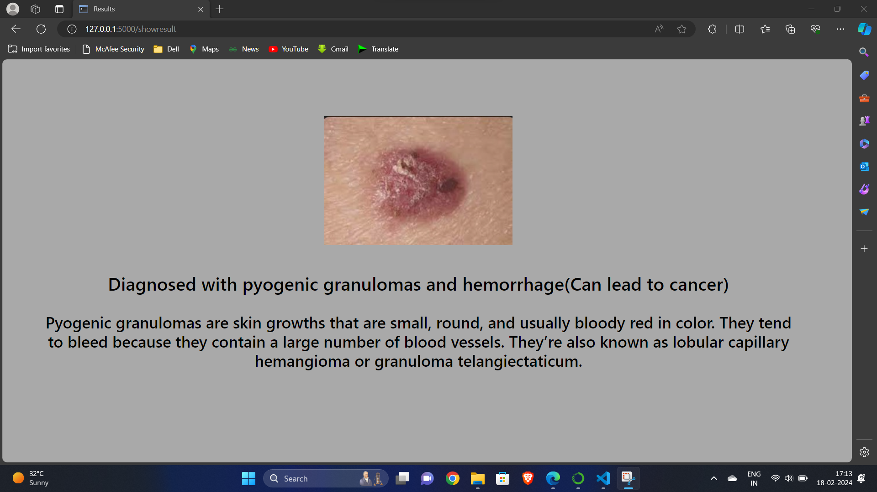
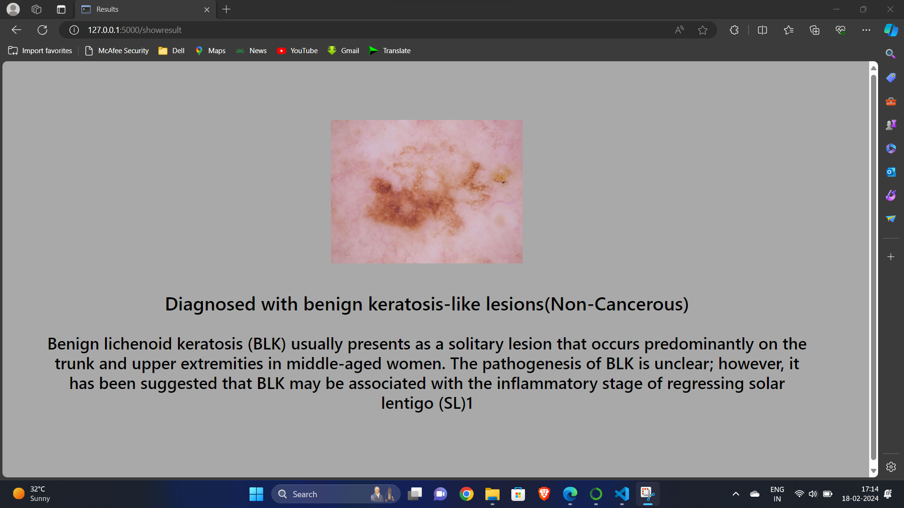
Outputs of 7 classes

Slide 18
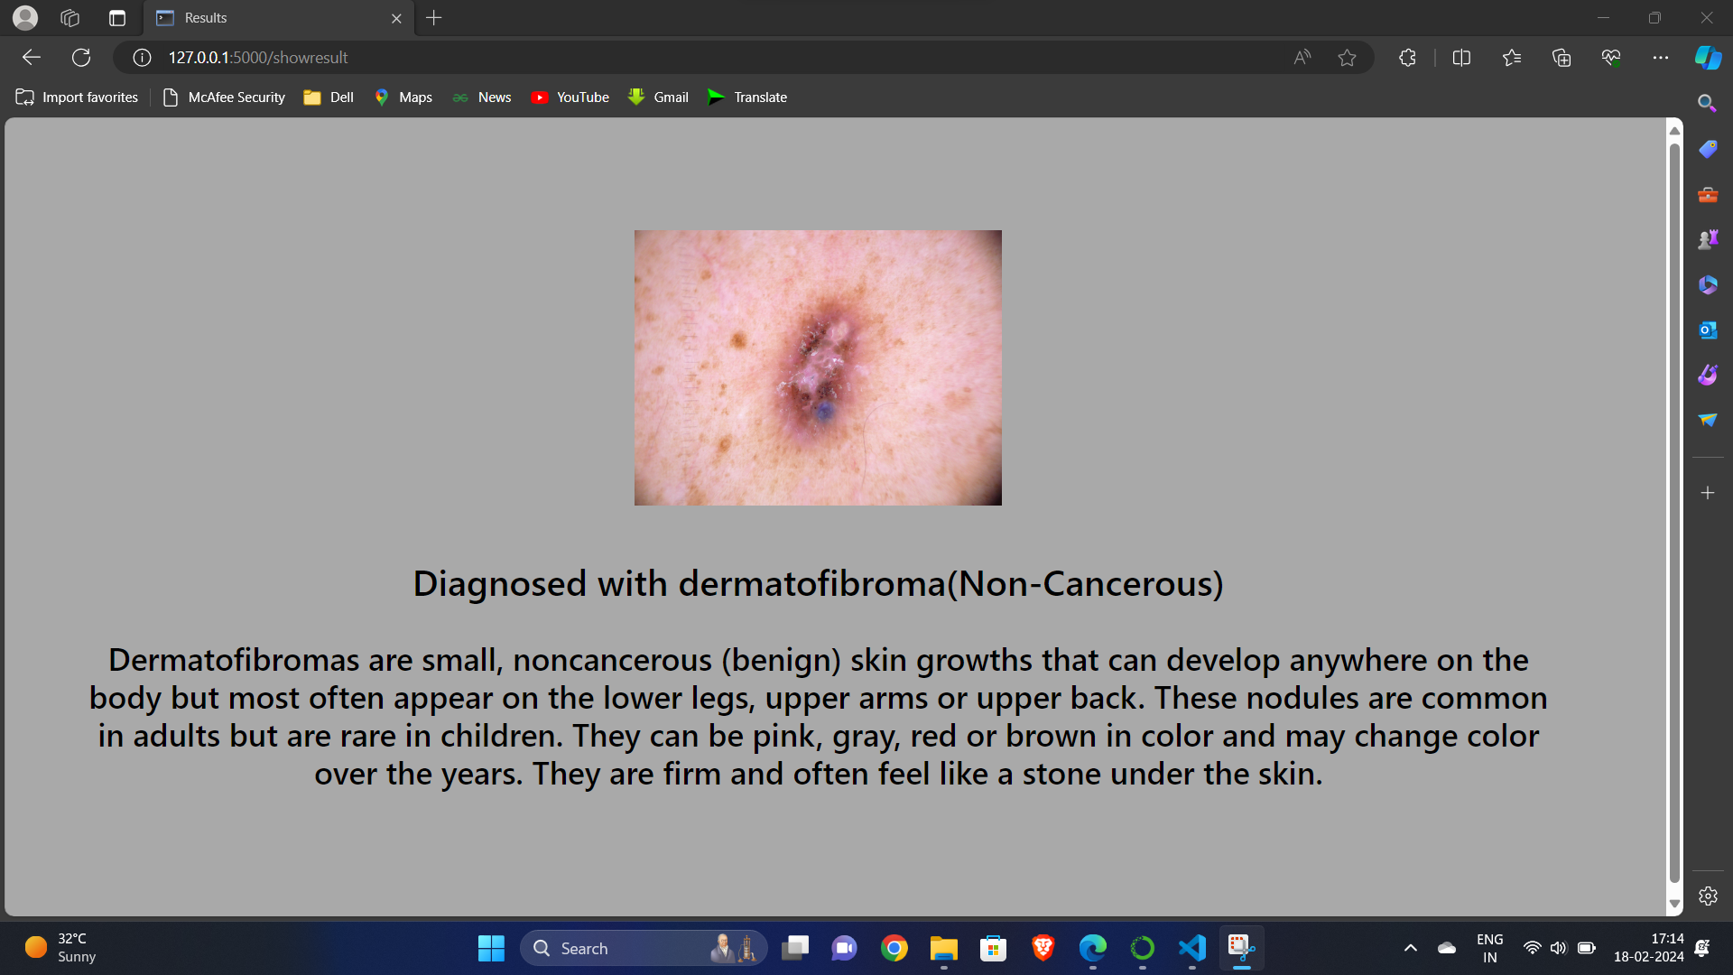
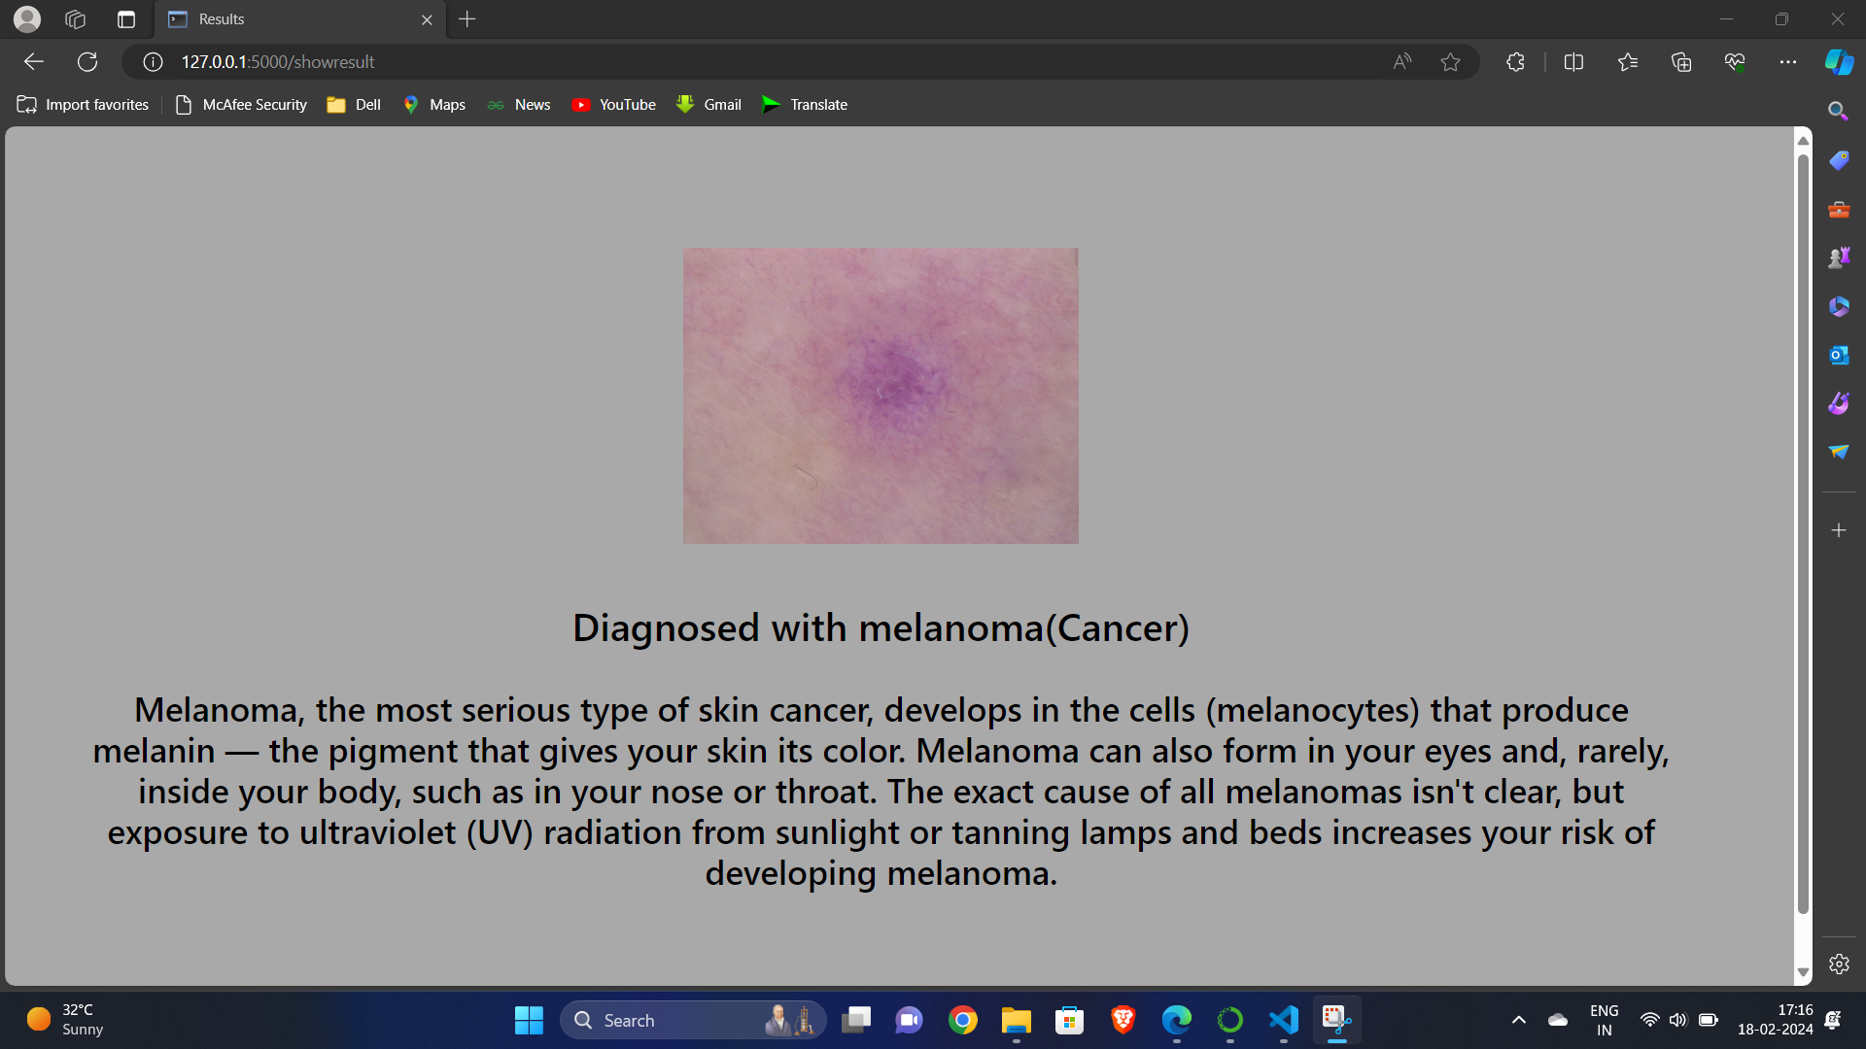
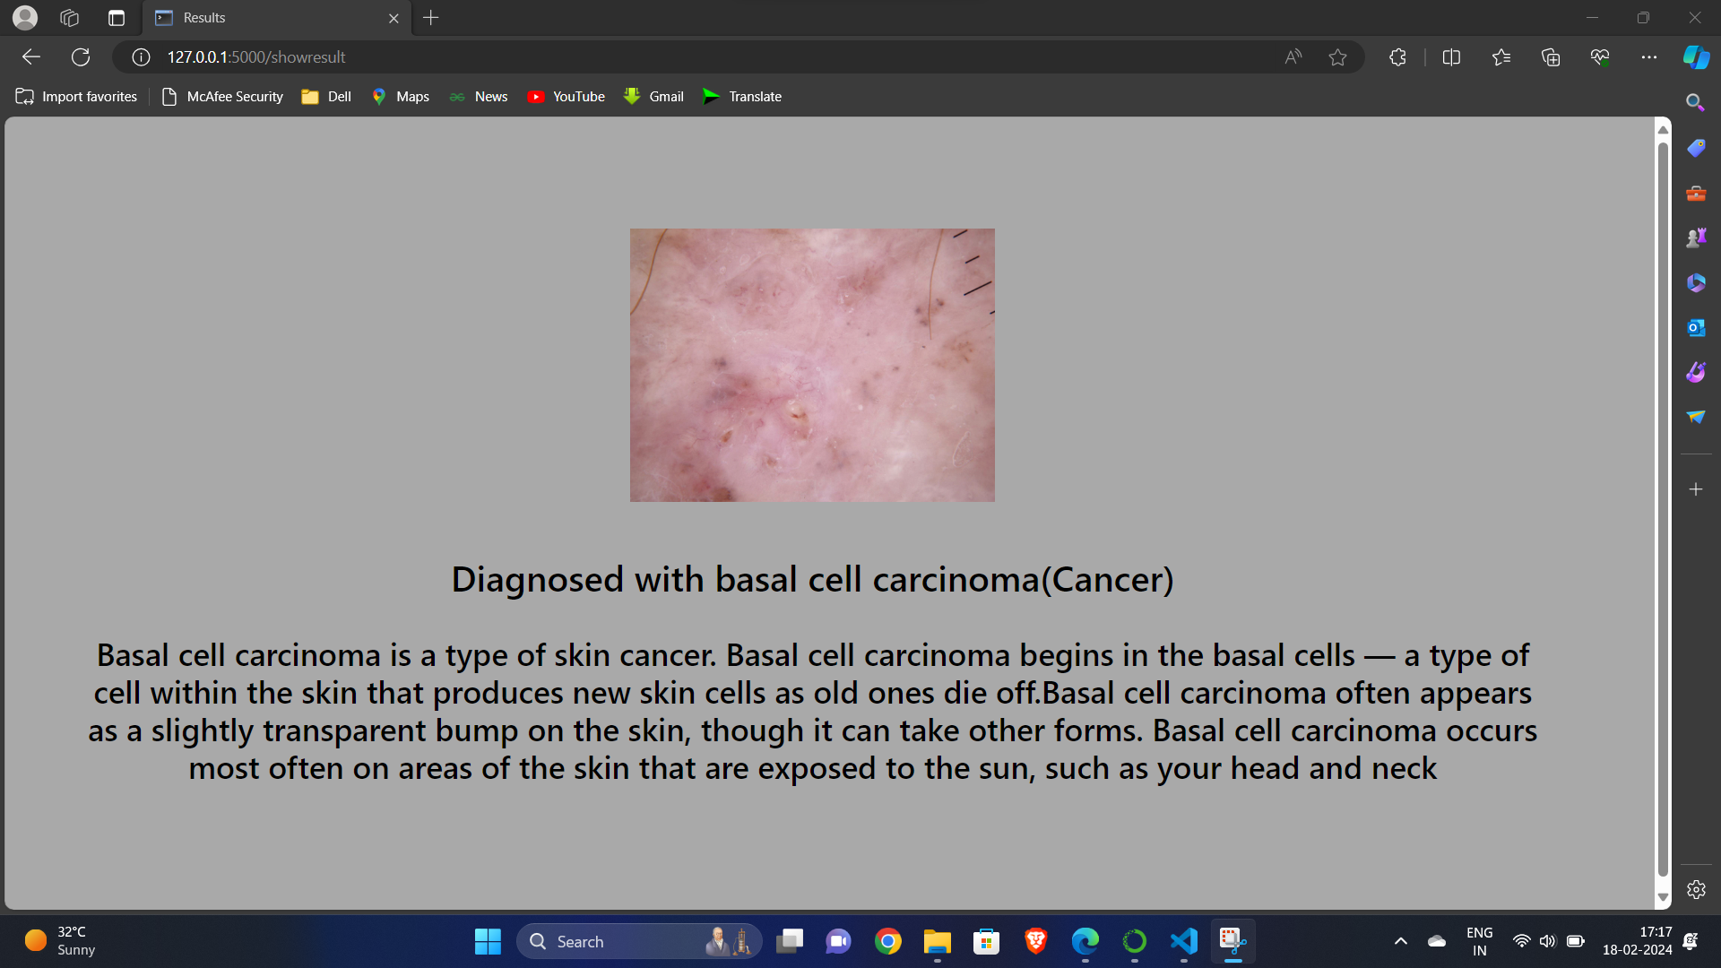
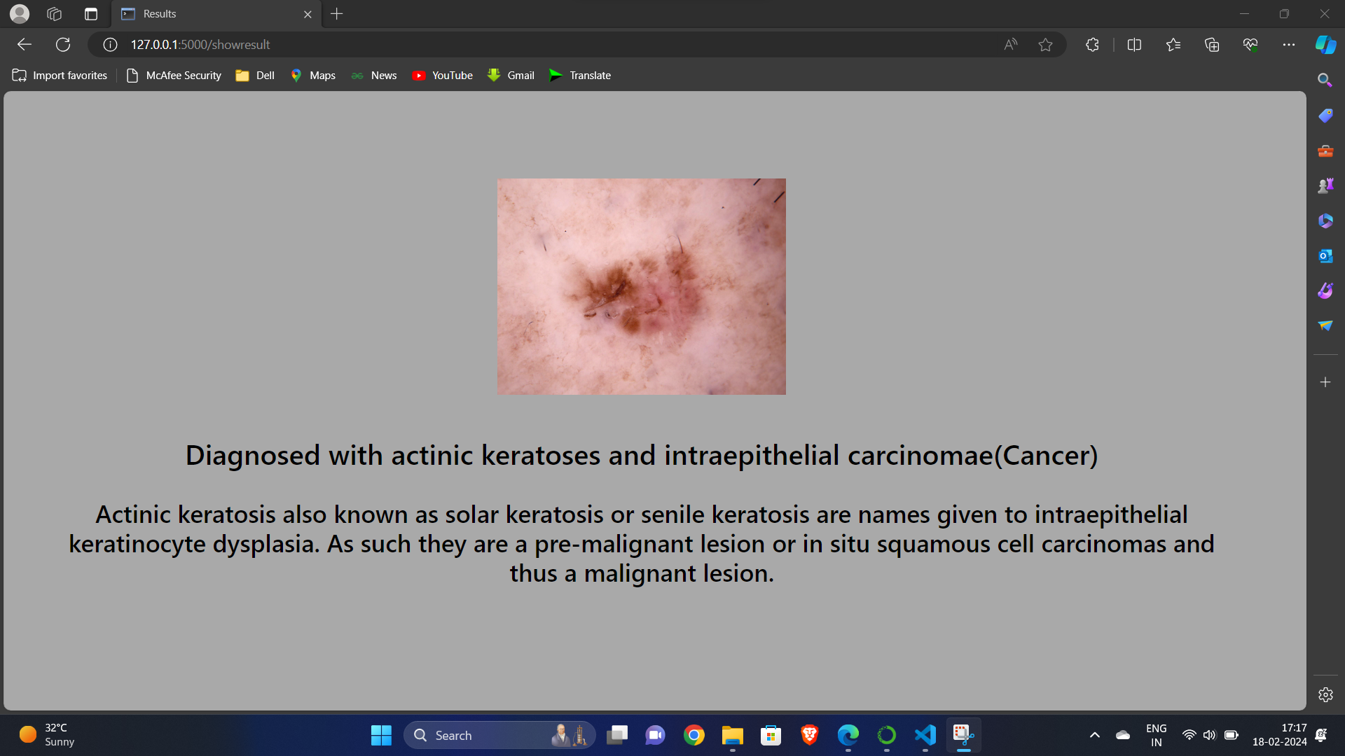
Cont…

Slide 19
Future scope
Looking ahead, there are promising avenues to explore for refining existing models.
Investigating ensemble methods that combine ResNet50, Inceptionv3, and VGG16 could yield a hybrid model harnessing the strengths of each architecture.
Enhancing datasets with more diversity and volume holds the potential for improving generalization. Exploring transfer learning and adapting models to evolving datasets can contribute to increased accuracy.
Collaborative efforts with healthcare professionals and integration into clinical workflows may facilitate practical applications, advancing the role of automated dermatological diagnosis in healthcare.

Slide 20
conclusion
The comparative analysis of ResNet50, Inceptionv3, and VGG16 highlights ResNet50 as the most effective method used in this investigation to classify skin tumours. It outperforms the other models in terms of accuracy and loss metrics.
In closing, the study successfully illustrates the possibility of models based on deep learning for the categorization of skin tumors, with ResNet50 exhibiting superior performance in accuracy and minimal loss.
While ResNet50 emerges as a robust choice, acknowledging the distinct strengths of Inceptionv3 and VGG16 emphasizes the importance of a tailored model selection based on specific needs.
The results underline the nature of model comparisons and the significance of understanding individual architectural characteristics.

Slide 21
references
[1] Vijayalakshmi, M. M. "Melanoma skin cancer detection using image processing and machine learning." International Journal of Trend in Scientific Research and Development (IJTSRD) 3.4 (2019): 780-784.
[2] Harangi, Balazs. "Skin lesion classification with ensembles of deep convolutional neural networks." Journal of biomedical informatics 86 (2018): 25-32.
[3] Thakur, Nikita, and Arunima Jaiswal. "Comparative Analysis of Machine Learning and Deep Learning Algorithms for Skin Cancer Detection." Machine Intelligence and Data Science Applications: Proceedings of MIDAS 2021. Singapore: Springer Nature Singapore, 2022. 409-418.
[4] Gong, An, Xinjie Yao, and Wei Lin. "Classification for dermoscopy images using convolutional neural networks based on the ensemble of individual advantage and group decision." IEEE Access 8 (2020): 155337-155351.
[5] Ali, Karar, et al. "Multiclass skin cancer classification using EfficientNets–a first step towards preventing skin cancer." Neuroscience Informatics 2.4 (2022): 100034.
[6] Pacheco, Andre GC, and Renato A. Krohling. "An attention-based mechanism to combine images and metadata in deep learning models applied to skin cancer classification." IEEE journal of biomedical and health informatics 25.9 (2021): 3554-3563.

Slide 22
Cont…
[7] Imran, Azhar, et al. "Skin cancer detection using combined decision of deep learners." IEEE Access 10 (2022): 118198-118212.
[8] Alizadeh, Seyed Mohammad, and Ali Mahloojifar. "Automatic skin cancer detection in dermoscopy images by combining convolutional neural networks and texture features." International Journal of Imaging Systems and Technology 31.2 (2021): 695-707.
[9] Han, Seung Seog, et al. "Keratinocytic skin cancer detection on the face using region-based convolutional neural network." JAMA dermatology 156.1 (2020): 29-37.
[10] Tschandl, Philipp, et al. "Expert-level diagnosis of non-pigmented skin cancer by combined convolutional neural networks." JAMA dermatology 155.1 (2019): 58-65.
[11] Haggenmüller, Sarah, et al. "Skin cancer classification via convolutional neural networks: systematic review of studies involving human experts." European Journal of Cancer 156 (2021): 202-216.
[12] Albahar, Marwan Ali. "Skin lesion classification using convolutional neural network with novel regularizer." IEEE Access 7 (2019): 38306-38313.

Slide 23
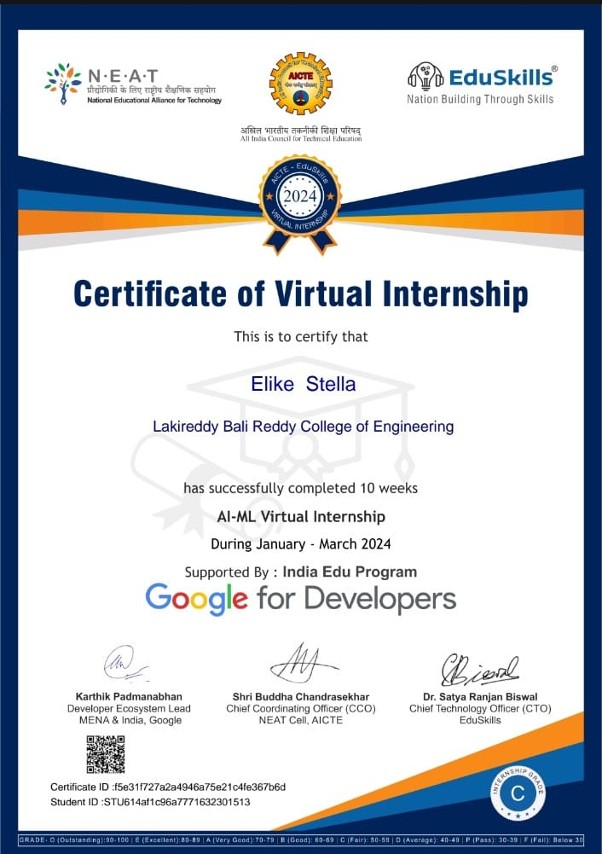
INTERNSHIPS
20761A05E9 E. Stella(Google AI-ML Virtual Internship by Eduskills)
The AI-ML Virtual Internship is a structured program which
provided a comprehensive understanding of artificial intelligence
and machine learning concepts.
Throughout the internship, I have done a series of modules and
hands-on projects aimed at fostering technical proficiency in
programming languages, machine learning algorithms,
and tools/frameworks relevant to AI and ML.
Key aspects of the internship include documenting the learning journey,
evaluating technical skills, reflecting on challenges and solutions,
analyzing project outcomes, exploring interdisciplinary learning, and
discussing personal growth and development.
In the internship, I have gained practical experience in AI and ML
and also developed problem-solving abilities, adaptability, and
interdisciplinary perspectives essential for success in the field.

Slide 24

20761A05J2 Y. Harshitha Sampath (Data engineering virtual internship by Eduskills)
Data engineering plays a pivotal role in modern data-driven organizations, facilitating the collection, storage, processing, and analysis of vast volumes of data.
With the proliferation of data sources and the advent of advanced technologies, data engineering has emerged as a critical discipline for unlocking actionable insights and driving informed decision-making.
Key components of data engineering include data ingestion, transformation, and storage, as well as the implementation of scalable and resilient data architectures.
By harnessing the power of data engineering, organizations can derive actionable insights, enhance operational efficiency, and gain a competitive edge in today's data-driven landscape.

Slide 25
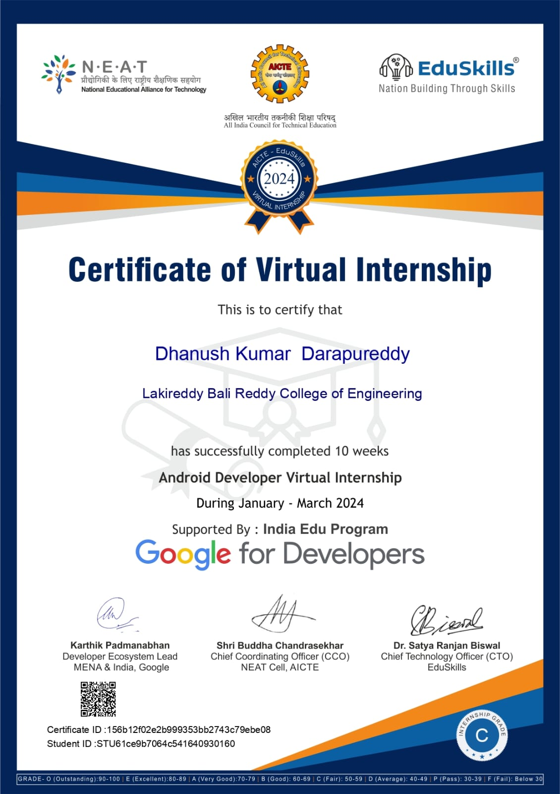
20761A05E8 D. Dhanush Kumar (Google Android Developer Virtual Internship by Eduskills)
The virtual internship in Android development provides me a comprehensive and immersive learning experience focused on mastering the Android platform, Kotlin programming language, Jetpack Compose, and other essential tools and concepts.
Through hands-on engagement and collaborative projects, interns gain proficiency in crafting robust mobile applications .
It also helped me to develop crucial problem-solving skills and industry-aligned practices.
The internship emphasizes not only technical skills but also fosters adaptability and resilience, preparing interns for the dynamic landscape of mobile application development.

Slide 26
THANK YOU

